Slide 1
Select Data
- Morshedul Arefin

Slide 2
Select Query
SELECT * FROM table_name
SELECT column_name(s) FROM table_name
$statement = $conn->prepare("SELECT * FROM students");
$statement = $conn->prepare("SELECT firstname,phone FROM students");

Slide 3
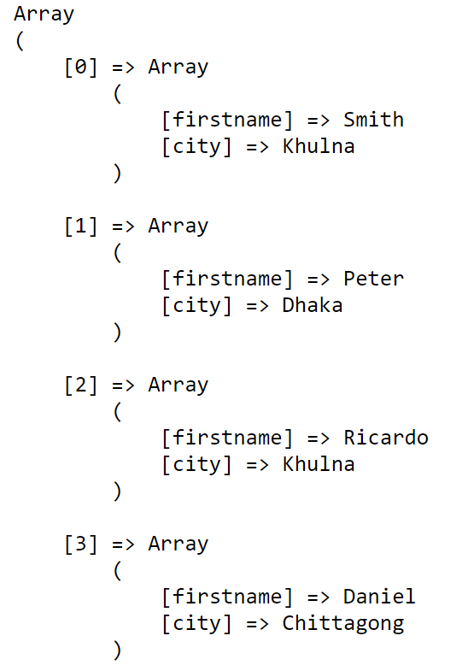
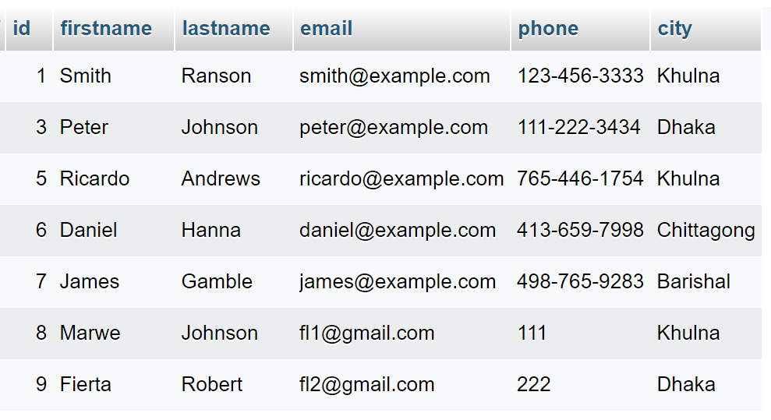
Select Query (…)
PDO::FETCH_ASSOC
- Retrieves data from a database query as an associative array
$statement = $conn->prepare("SELECT firstname,city
FROM students");
$statement->execute();
$result = $statement->fetchAll(PDO::FETCH_ASSOC);

Slide 4
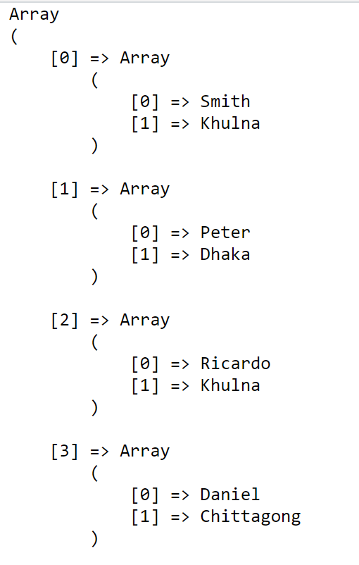
Select Query (…)
PDO::FETCH_NUM
- Retrieves data from a database query as a numeric array
$statement = $conn->prepare("SELECT firstname,city
FROM students");
$statement->execute();
$result = $statement->fetchAll(PDO::FETCH_NUM);

Slide 5
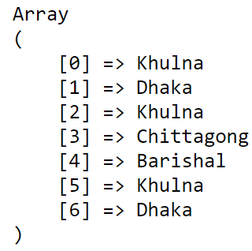
Select Query (…)
PDO::FETCH_COLUMN
- Get plain one-dimensional array.
- First column (from select items first one) will be fetched
$statement = $conn->prepare("SELECT city,firstname FROM students");
$statement->execute();
$result = $statement->fetchAll(PDO::FETCH_COLUMN);

Slide 6
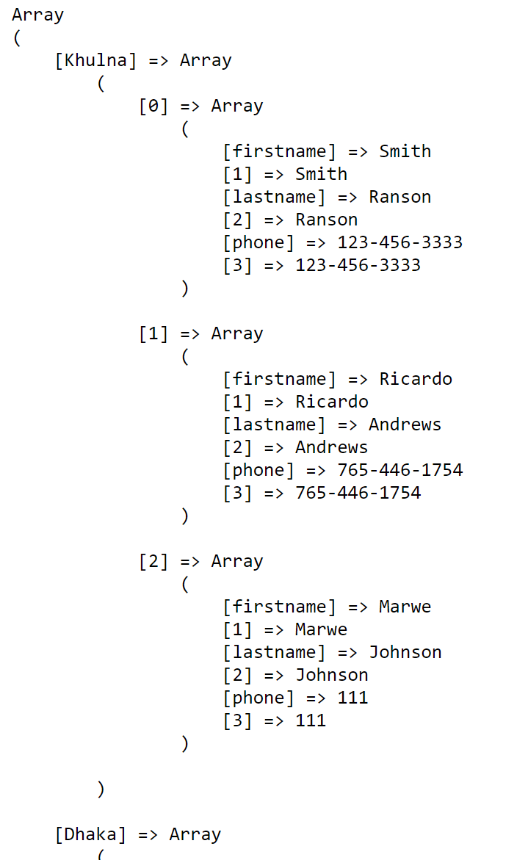
Select Query (…)
PDO::FETCH_GROUP
This mode groups the returned rows into a nested array,
where indexes will be unique values from the first column, and
values will be arrays similar to ones returned by regular fetchAll().
$statement = $conn->prepare("SELECT city,firstname,lastname,
phone FROM students");
$statement->execute();
$result = $statement->fetchAll(PDO::FETCH_GROUP);

Slide 7
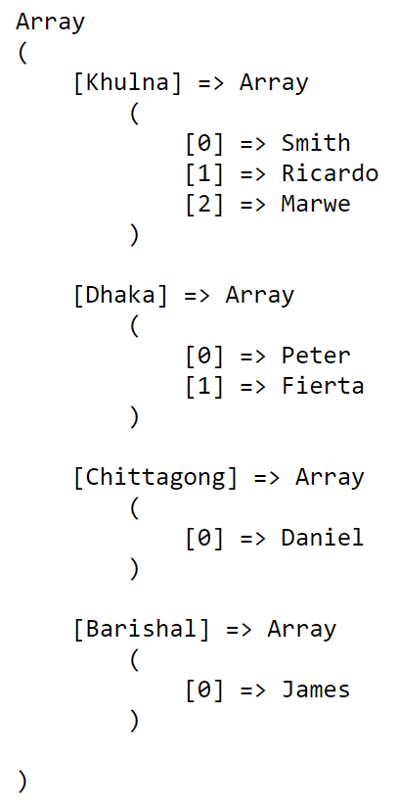
Select Query (…)
PDO::FETCH_GROUP | PDO::FETCH_COLUMN
This one groups the first column with all values from the second column.
$statement = $conn->prepare("SELECT city,firstname,lastname,phone
FROM students");
$statement->execute();
$result = $statement->fetchAll(PDO::FETCH_GROUP | PDO::FETCH_COLUMN);

Slide 8
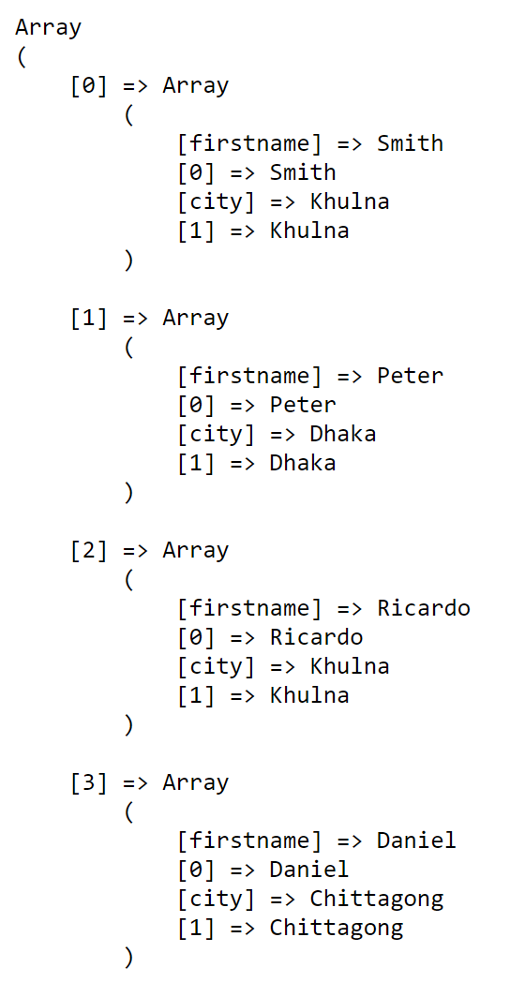
Select Query (…)
PDO::FETCH_BOTH
- Retrieves data from a database query as an associative array and a numeric array
$statement = $conn->prepare("SELECT firstname,city FROM students");
$statement->execute();
$result = $statement->fetchAll(PDO::FETCH_BOTH);

Slide 9
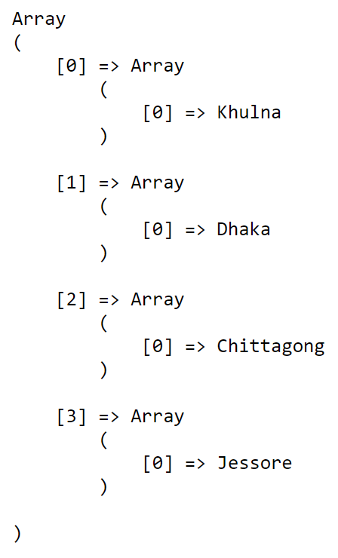
Distinct Statement
- It is used to return only distinct (different) values
Example:
$statement = $conn->prepare("SELECT distinct(city) FROM students");
$statement->execute();
$result = $statement->fetchAll(PDO::FETCH_NUM);

Slide 10
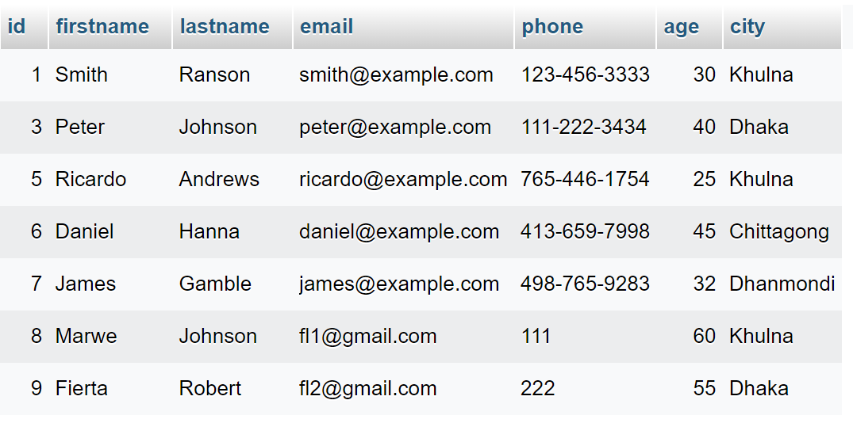
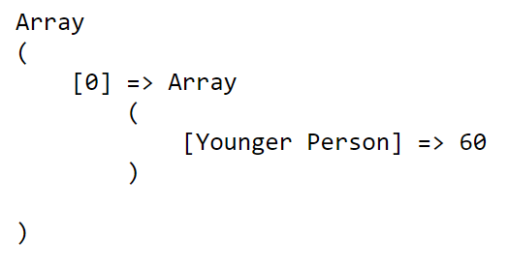
MIN() and MAX () Functions
- SELECT MIN returns the smallest value for a column.
- SELECT MAX returns the largest value for a column.
Example:
$statement = $conn->prepare("SELECT MAX(age) as 'Younger Person' FROM students");
$statement->execute();
$result = $statement->fetchAll(PDO::FETCH_ASSOC);

Slide 11
COUNT(), SUM(), AVG() Functions
- COUNT, SUM, and AVG are aggregate functions.
- COUNT returns a count of the number of data values.
- SUM returns the sum of the data values.
- AVG returns the average of the data values.
SELECT COUNT(column-name) FROM table-name
SELECT SUM(column-name) FROM table-name
SELECT AVG(column-name) FROM table-name

Slide 12
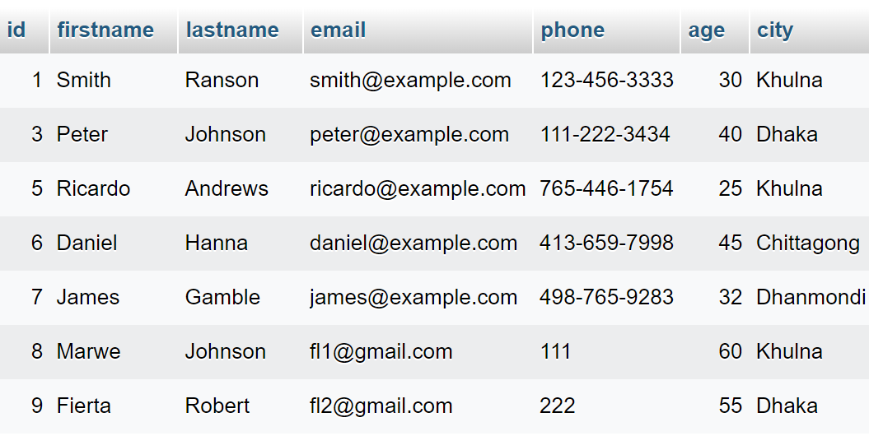
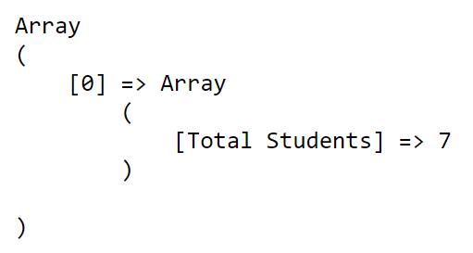
COUNT(), SUM(), AVG() …
- Total number of students in the table
$statement = $conn->prepare("SELECT COUNT(id) as 'Total Students' FROM students");
$statement->execute();
$result = $statement->fetchAll(PDO::FETCH_ASSOC);

Slide 13
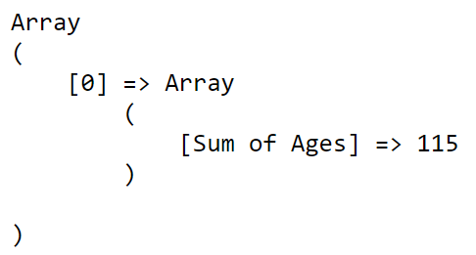
COUNT(), SUM(), AVG() …
- Summation of ages of students who live in Khulna City
$statement = $conn->prepare("SELECT SUM(age) as 'Sum of Ages' FROM students WHERE city=?");
$statement->execute(['Khulna']);
$result = $statement->fetchAll(PDO::FETCH_ASSOC);

Slide 14
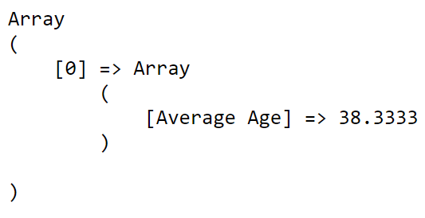
COUNT(), SUM(), AVG() …
- Average of ages of students who live in Khulna City
$statement = $conn->prepare("SELECT AVG(age) as ‘Average Age' FROM students WHERE city=?");
$statement->execute(['Khulna']);
$result = $statement->fetchAll(PDO::FETCH_ASSOC);

